Slide 1
Project 2
Group Members:
Tim Tang
Fred Tinio
Kevin Ewing
Laura De Morneau

Slide 2
Extract Process

Slide 3
Transformation Process

Slide 4
Load Process

Slide 5





Project 2 – ETL Process Flowchart
Data Acquisition
Data Integration
Data Repository
Presentation &
Visualization Layer
External Sources
Insights and Management Tools
External & Legacy Information Sources
Brand
JSON
Jupyter Notebook
MySQL / Pandas
Marketing
CDC Zike Data .csv
Database 1
Touch Point
Touch Point Person
Census Data 2 .csv
Automation / Reporting and Analytical Tools
Field Marketer
Reports
USPS NCOA
Consumer
Database 2
Census Data .csv
Response Data
Device Data
Leads Agents
Common End to End Audit and Validation Data

Slide 7
Appendix

Slide 8
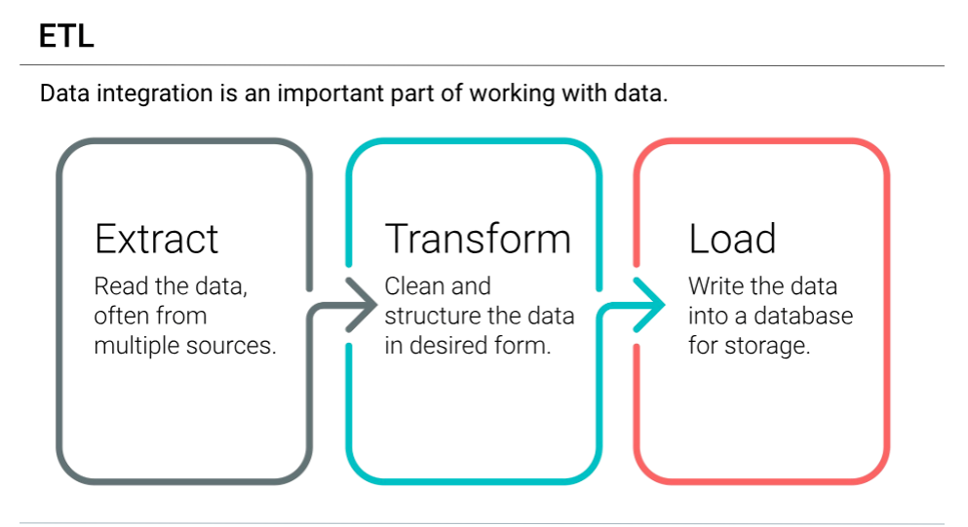

Slide 9
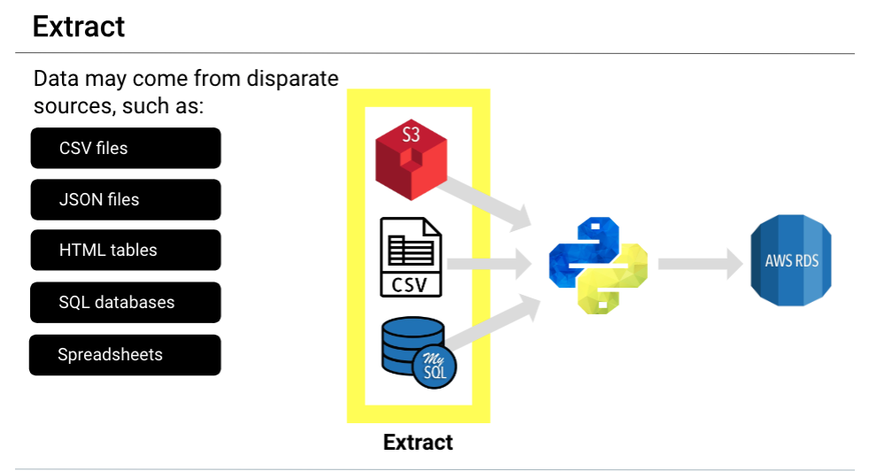

Slide 10
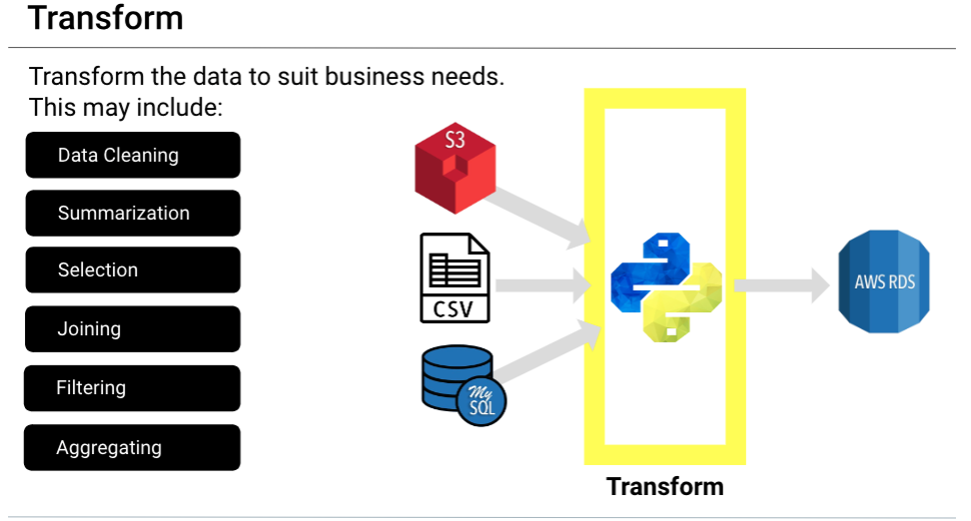

Slide 11
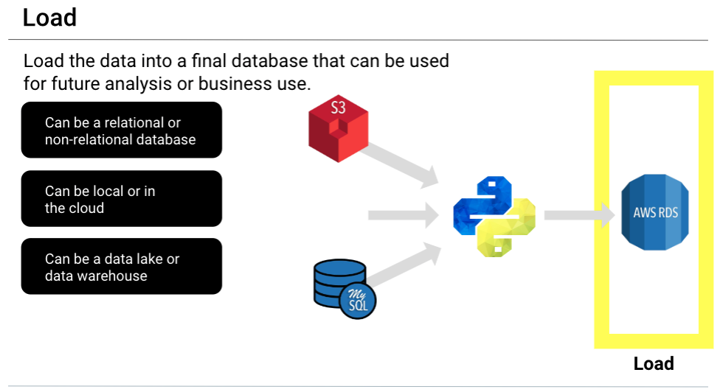

Slide 12
MTL MDB Data Architecture will have the following key components
Data Acquisition
Data Integration
Data Repository
Presentation &
Visualization Layer
External Sources
Market Insight and Management Tools
External & Legacy Information Sources
WSDL
Siebel CRM
MAT
COTS DB
Brand
SFTP IN
Data profile and Quality
Staging
Marketing
Sales Force
Touch Point
Planning and Operations Tools
Legacy Data sources
Touch Point Person
Response Data*
MI / MM
COTS DB
Transaction Info (CPP)
Field Marketer
Reports
Customer Info (CIS)
Consumer
Marketing Automation / Reporting and Analytical Tools
Product Info (PBI)
Response Data
MDB
Ch. / Partner Info (PRM)
Device Data
Registrations / Events (WAS)
Leads Agents
Common End to End Audit Data

